Slide 1


Slide 2

1
PROJECT DESCRIPTION :
A Maze-solving project with varying Difficulty levels, Time limits and Secret Paths
Mazes solved by various algorithms
Breadth First Algorithm
Depth First Algorithm
Dijkstra’s Algorithm
A* Algorithm

Slide 3
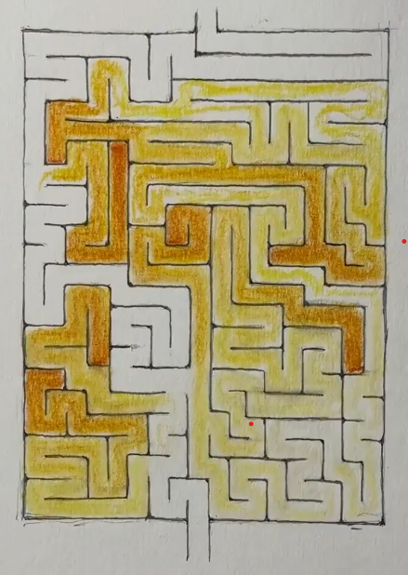
1
PROJECT DESCRIPTION :
A Maze-solving project with varying Difficulty levels, Time limits and Secret Paths
Mazes solved by various algorithms
Breadth First Algorithm
Depth First Algorithm
Dijkstra’s Algorithm
A* Algorithm
Simple Maze

Slide 4
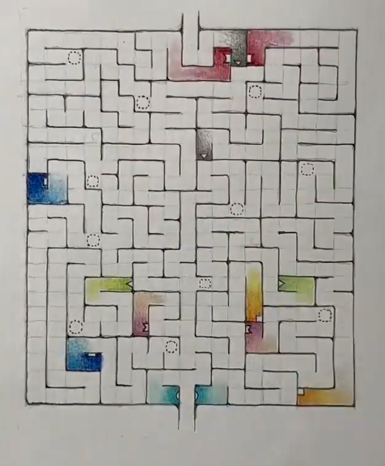
1
PROJECT DESCRIPTION :
A Maze-solving project with varying Difficulty levels, Time limits and Secret Paths
Mazes solved by various algorithms
Breadth First Algorithm
Depth First Algorithm
Dijkstra’s Algorithm
A* Algorithm
Maze with secret Paths

Slide 5
1
PROJECT DESCRIPTION :
A Maze-solving project with varying Difficulty levels, Time limits and Secret Paths
Mazes solved by various algorithms
Breadth First Algorithm
Depth First Algorithm
Dijkstra’s Algorithm
A* Algorithm
Simple Maze
Maze with secret Paths

